Slide 1
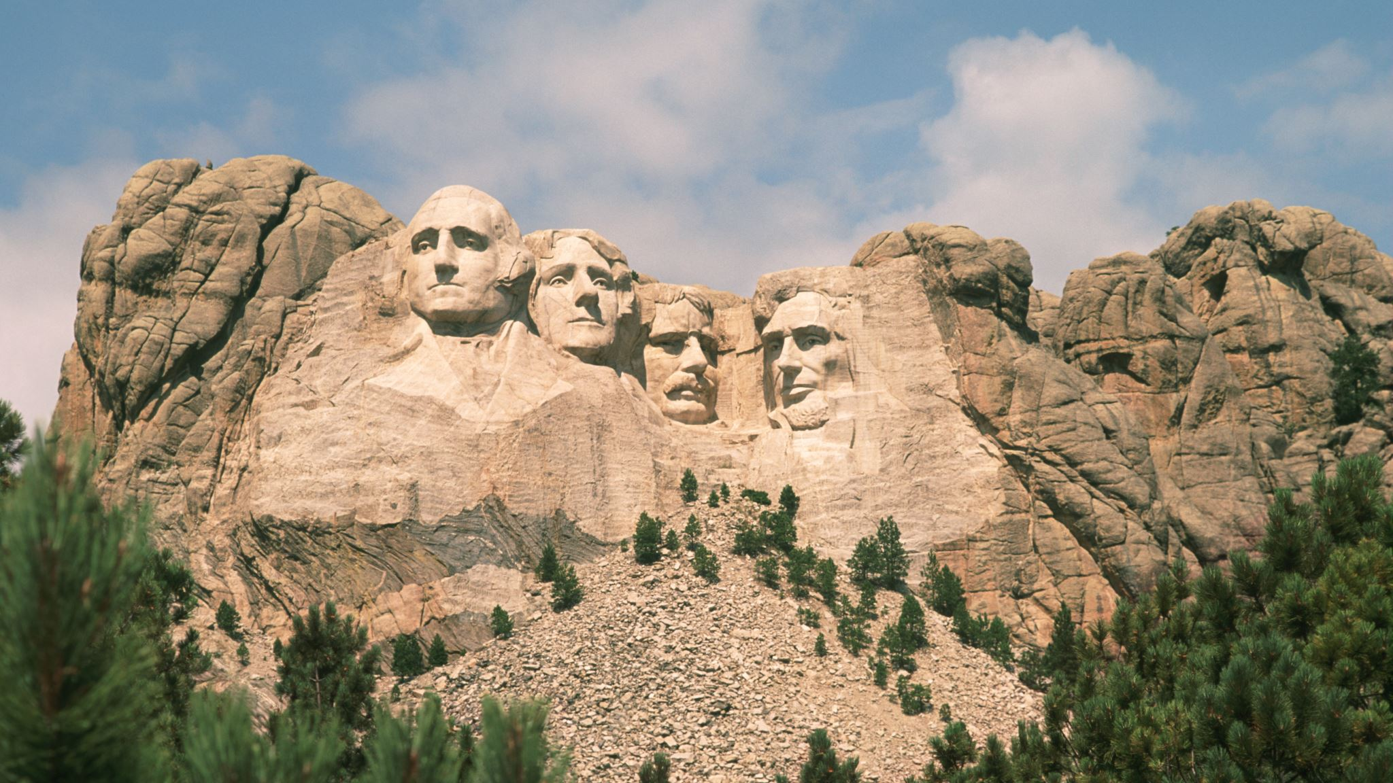
GOV. PAUL HAMILTON
Who was he and why do we HONOR HIM?
B. RANDOLPH ATKINS
GOV. PAUL HAMILTON CHAPTER
SOUTH CAROLINA SOCIETY, SONS OF THE AMERICAN REOLUTION

Slide 2
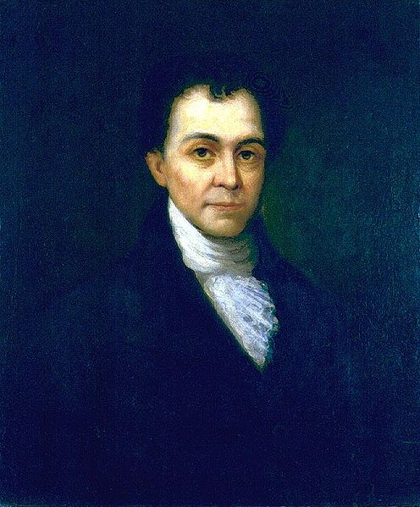
GOV. PAUL HAMILTON
We honor him because:
He was a battle-proven Patriot!
He was a South Carolina Lowcountry landowner and planter;
He was a successful politician after the Revolutionary War who rose from justice of the peace, tax collector and parish commissioner to the State Legislature, and served as Comptroller of Finance, where he greatly improved the financial system;
He was a member of the SC delegation that ratified the Constitution;
He was the elected Governor of SC by the Legislature; and,
He served as the third Secretary of the Navy.

Slide 3
PAUL HAMILTON
Born: Oct. 16, 1762 in Willtown, St. Paul’s Parish, SC ,the only surviving son of Archibald and Rebecca Branford Hamilton;
Was educated by a private tutor in Charleston until 1778 when he, reportedly, left for lack of funds and volunteered at the age of 16 for the South Carolina Militia.
Young Hamilton served at the siege of Savannah (Sept – Oct. 1779) and the Battle of Camden (Aug. 1780).
He later served with Gen. Francis Marion and under William Harden during the capture of Fort Balfour (April 13, 1781).

Slide 4
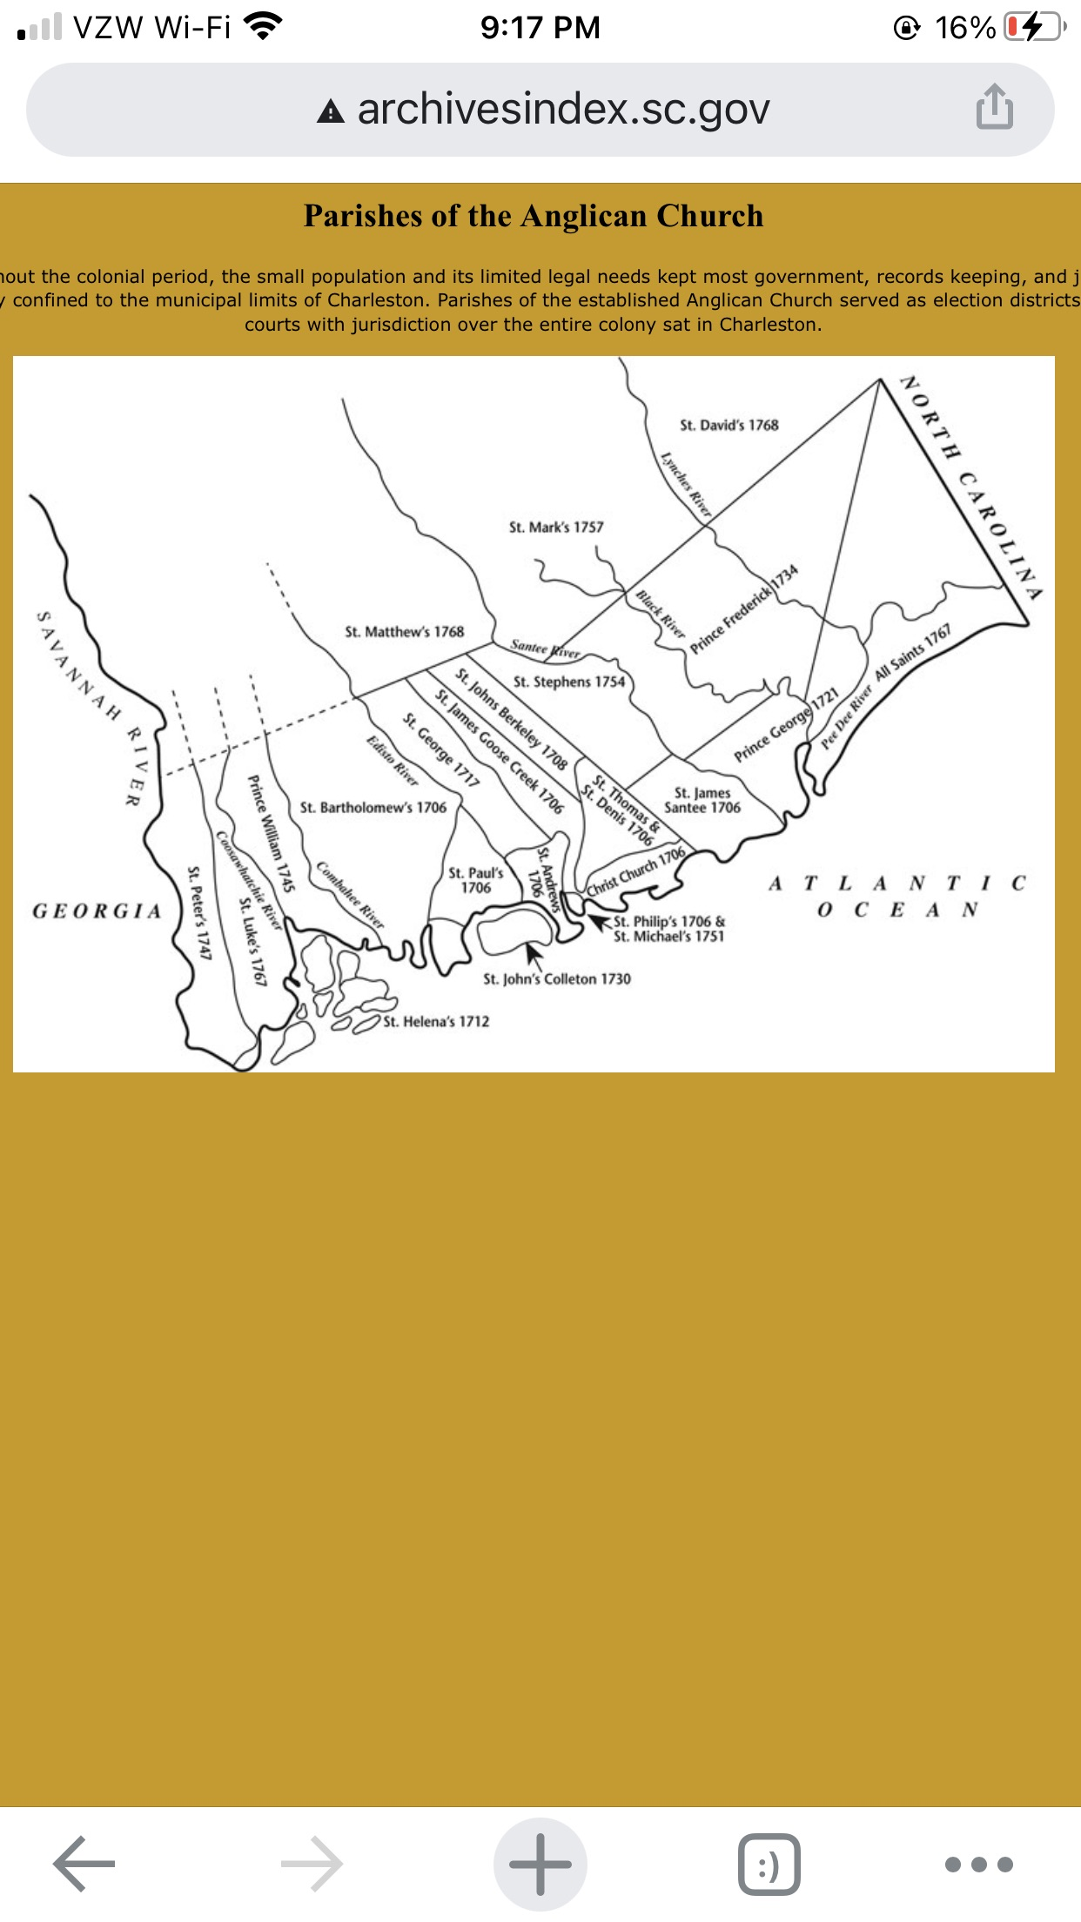
The Parishes of South Carolina
Paul Hamilton was born in Willtown, St. Paul’s Parish, in 1762

Slide 5
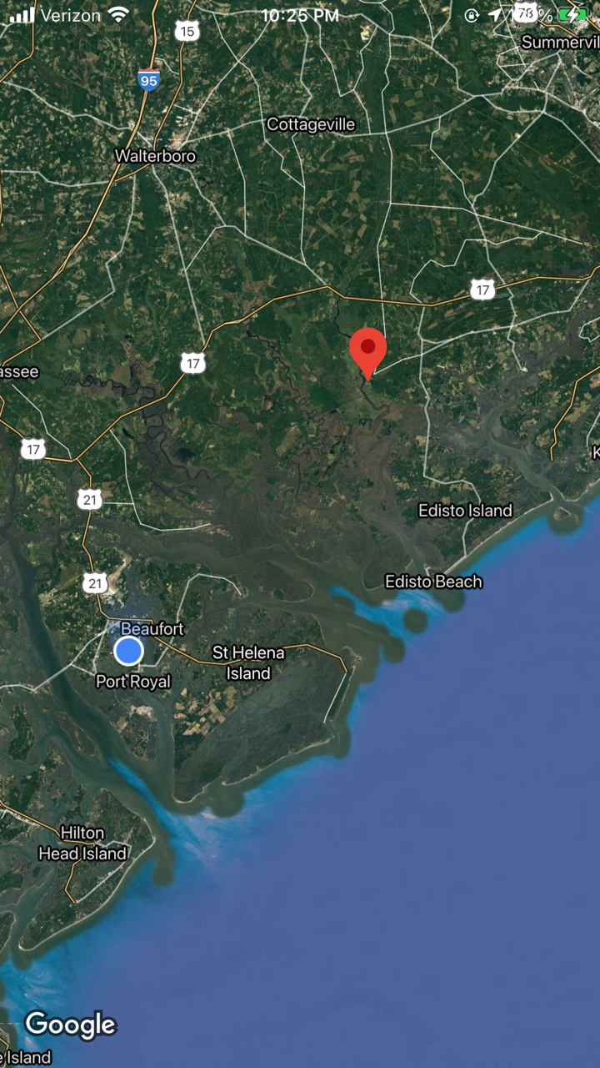
Willtown, SC
(aka Wilton and New London)
Located on the S. Edisto River in Charleston Co., it is an historic settlement founded in 1704 that served as a local government center and regional commercial center.+

Slide 6
PAUL HAMILTON - PLANTER
Paul Hamilton inherited his father's lands in St. Paul’s Parish but initially cultivated indigo on Edisto Island during 1782 and 1783.
He had moved back to St. Paul’s by 1788 and cultivated rice. Tax records indicate he owned 1,602 acres and 36 slaves.
From land grants made after 1786 he added 828 acres along the Edisto River and 447 acres along the Little Salkehatchie.
By 1790, however, he had sold his St. Paul’s property and established himself on a leased plantation in the adjacent Parish of St. Bartholomew where census records listed 47 slaves in residence.

Slide 7
PAUL HAMILTON - POLITITIAN
Hamilton was elected to the SC House of Representatives – St. Paul’s Parish and served from 1785 through 1786;
House of Representatives – St. Bartholomew's Parish in 1788;
The SC State Senate – St. Bartholomew’s - 1794 – 1799 (through the 11th thru 13th General Assemblies) and again during the 18th Assembly (1808-1809), serving as Chairman, Committee of Public Accounts;
Comptroller of Finance – 5-Mar-1800 - Dec. 1804, and greatly improved the State’s financial system.
Governor: 10-Dec-1804 – during which he advocated for military preparedness through improvements to state militia laws and coastal defenses. He also called for penal code revision and a ban on Atlantic slave trade.

Slide 8
PAUL HAMILTON
SECRETARY OF THE NAVY
President James Madison appointed Hamilton as 3rd Secretary of the Navy on 15-May-1809 to geographically balance his administration.
Hamilton advocated for increased naval preparedness by building new ships and increasing coastal fortifications;
Supported the Naval Hospitals Act of 1811, which established naval hospitals, though none were constructed until years later; and,
Encouraged the development of steam engine warships.
While he was dismissed by Pres. Madison and his term as Secretary deemed controversial, three Navy ships have been named in honor of Secretary of the Navy Paul Hamilton: the USS Paul Hamilton (DD-307) – 1920-1931; USS Paul Hamilton (DD-590) – 1943-1970; and the USS Paul Hamilton (DDG-60) – 1995-Present.

Slide 9
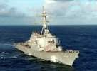
USS Paul Hamilton (DDG-60)
Commissioned 1995

Slide 10
